Slide 1
HANGMAN GAME
PYTHON PROGRAM
Submitted by-
Swati Saini Roll-17
Bhavnath Jha Roll-33
Shubham Kalihari Roll-44

Slide 2
What is hangman game ?
Hangman is a paper and pencil guessing game for two or more players. One player thinks of a word, phrase or sentence and the other tries to guess it by suggesting letters or numbers, within a certain number of guesses.
The word to guess is represented by a row of dashes, representing each letter of the word. If the guessing player suggests a letter which occurs in the word, the other player writes it in all its correct positions. If the suggested letter or number does not occur in the word, the other player draws one element of a hanged man stick figure as a tally mark.

Slide 3
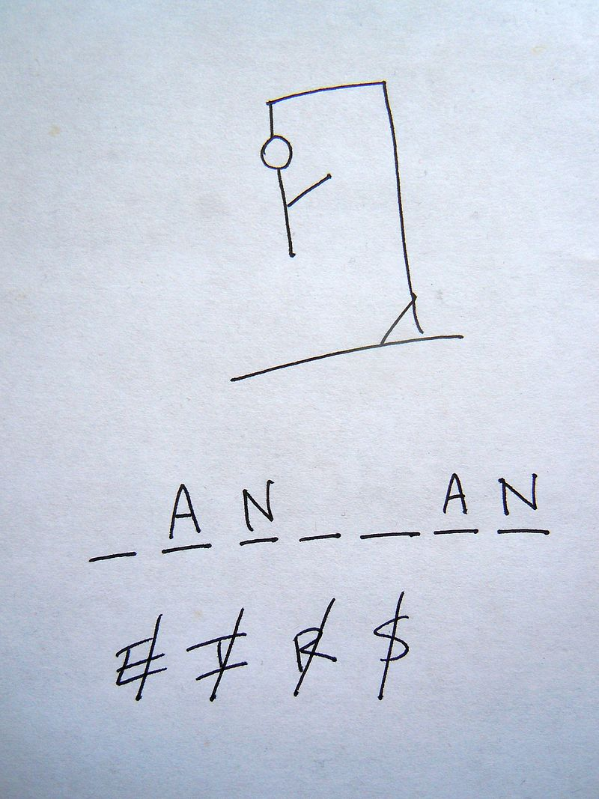
The underlined letters appear in the
word in their correct places,
while the crossed-out letters do not appear,
and each crossed-out letter corresponds
to one part of the drawing.
In this case, the secret word is “hangman”

Slide 4
Objective
The main objective of this project is to provide traditional way of playing hangman game, to create a program which contain graphical user interface for playing the game. In this game the computer will chose any random word from the list and the player or guesser have to guess the whole word before he lose all is chance.

Slide 5
Our Program
In our program the player who gives word is computer and the guesser is the player. Computer choose random word from a list, then computer give starting letter and the last letter of the word and also computer give total number of letter in the word . Now the user have to guess the whole word, if the word is wrong then one part of the hangman will be created by the computer. If the player could not complete the word before the hangman is created , he will lose the game and a losing message box will be shown and if he or she guesses the word before he will win the match and a winning message box will be shown.

Slide 6
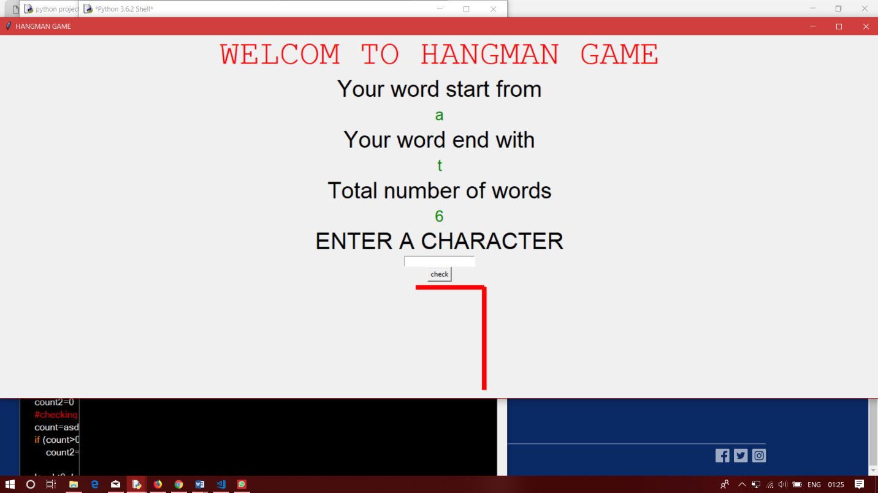
Screen shots

Slide 7
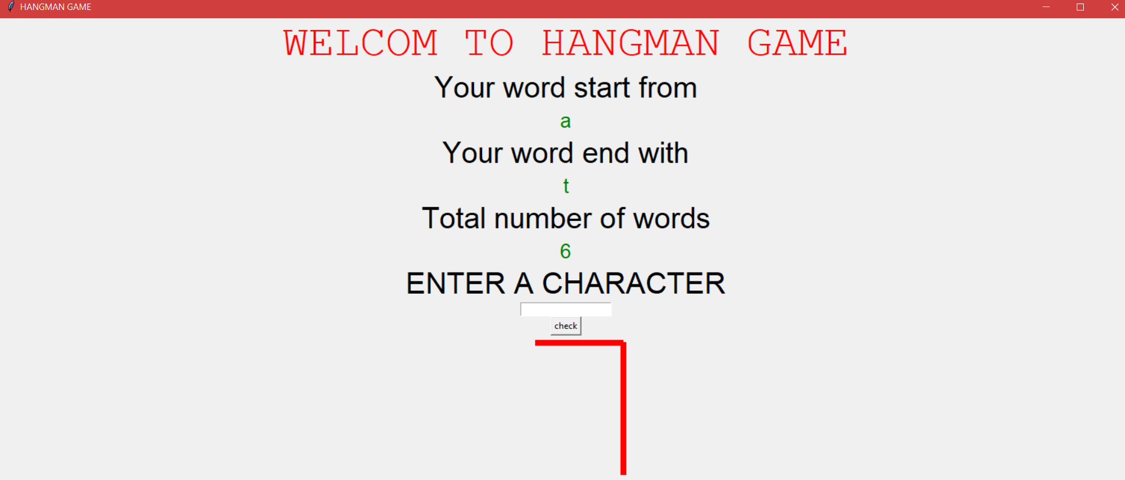
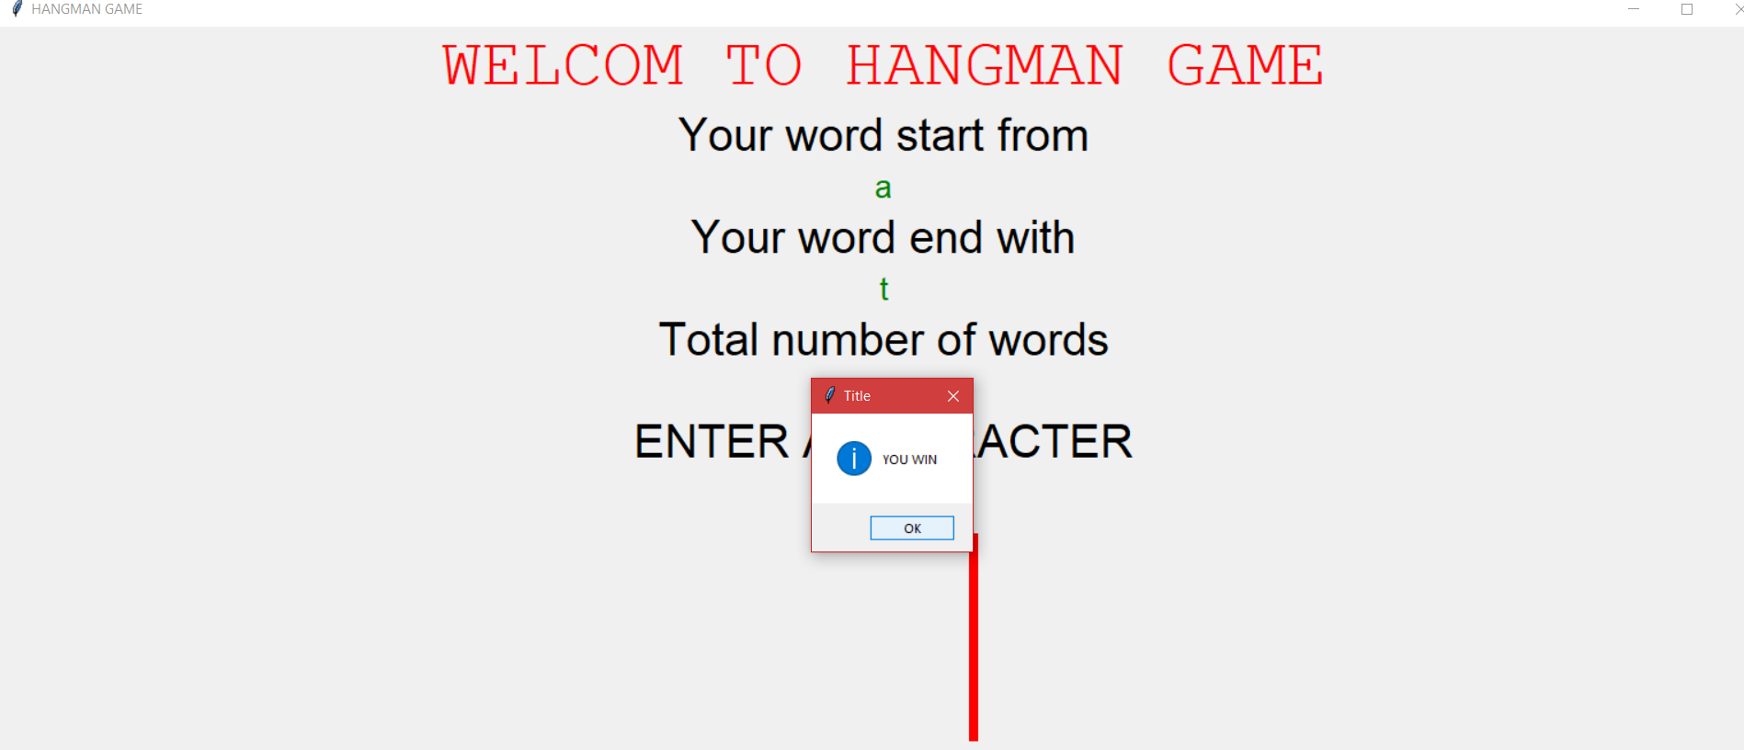

Slide 8
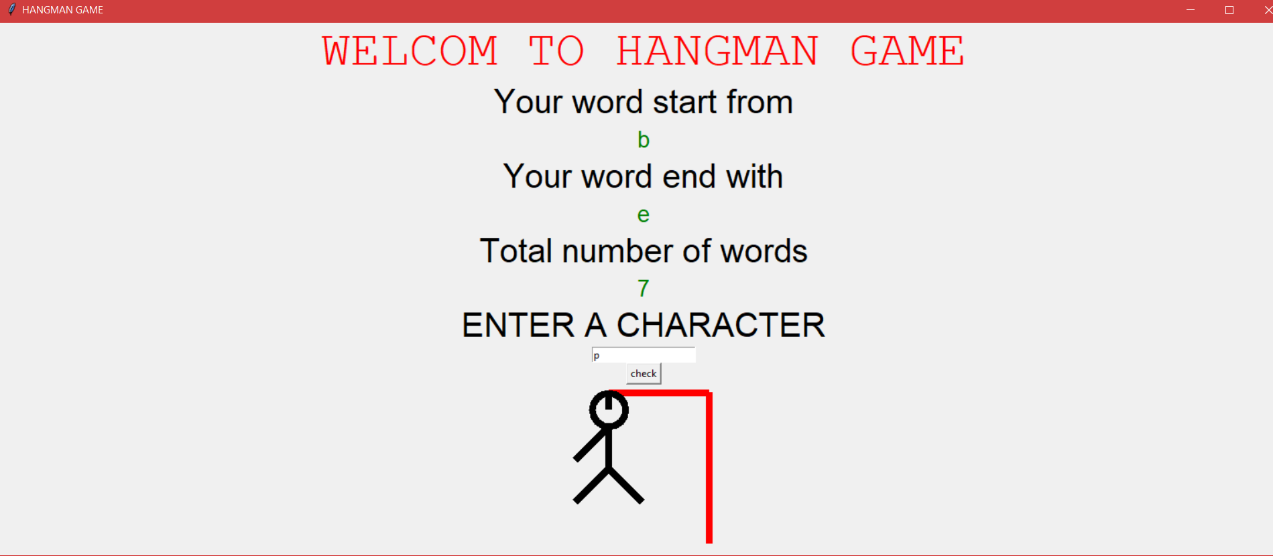
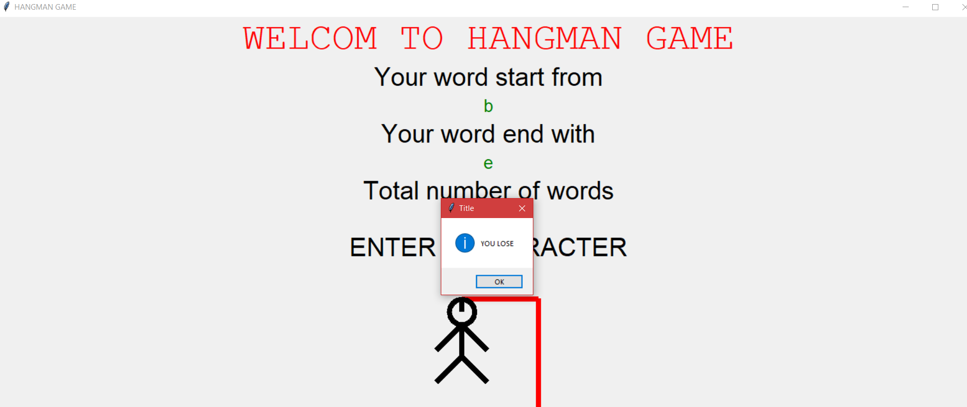

Slide 9
References
http://stackoverflow.com
http://www.wb3school.com
http://www.codeacademy.com
Introduction to programming using python

